Slide 1
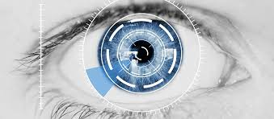
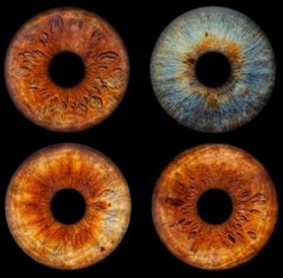
Pupil/Iris Radius Ratio Determination
Dr. Prashant P Patavardhan
Professor-ECE
RV INSTITUTE OF TECHNOLOGY AND MANAGEMENT®, BENGALURU

Slide 2
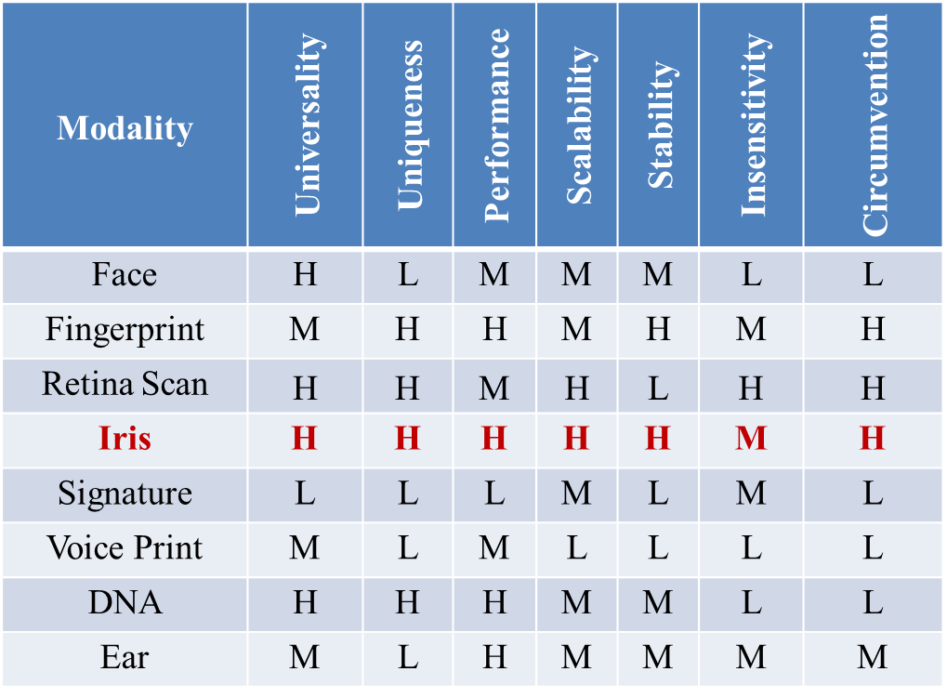
Comparison of Various Biometric Modalities

Slide 3
Features of IRIS
It remains unchanged throughout a lifetime of a person.
In the third month of gestation period the iris pattern is formed, and in the eighth month the structure becomes stable.
Since the protection to the iris is provided by the cornea, the iris gets rarely affected by the external elements.
The eye surgery seldom impacts or affects the iris as it is performed on the retina or on the cornea.
Iris biometric doesn’t involve any physical contact thus making it easier to accept.
Finally, for spoofing or circumventing iris is also the toughest biometrics.

Slide 4
Introduction to Iris-Based Diagnosis
Iris Diagnosis Concept
Iris diagnosis is a non-invasive method that uses patterns, colors, and structures in the iris to analyze an individual's health condition.
Brief History
This technique has roots in alternative medicine practices and has been modernized using digital technology for better accuracy.

Slide 5
Why Use the Iris for Diagnosis?
Unique Patterns
The iris has a unique structure for every individual, which can reflect the state of internal organs and body systems.
Non-Invasive and Painless
The method doesn’t require invasive procedures, making it patient-friendly and easy to repeat for ongoing monitoring.
Early Detection of Health Conditions
Through iris analysis, it is possible to detect early signs of diseases related to organs such as the liver, kidneys, and digestive system.

Slide 6
Anatomy of the Iris
Iris Zones
The iris is divided into several zones, each corresponding to different parts of the body.
These zones reflect organs like the heart, lungs, and kidneys.
Key Features in the Iris
Crypts
Irregular dark spots that indicate weaknesses in specific organs or systems.
Color Variations
Changes in iris color might reveal toxin buildup or blood flow issues.
Rings and Nerve Fibers
The presence of rings or nerve fiber disorganization can signify stress or circulatory issues.

Slide 7
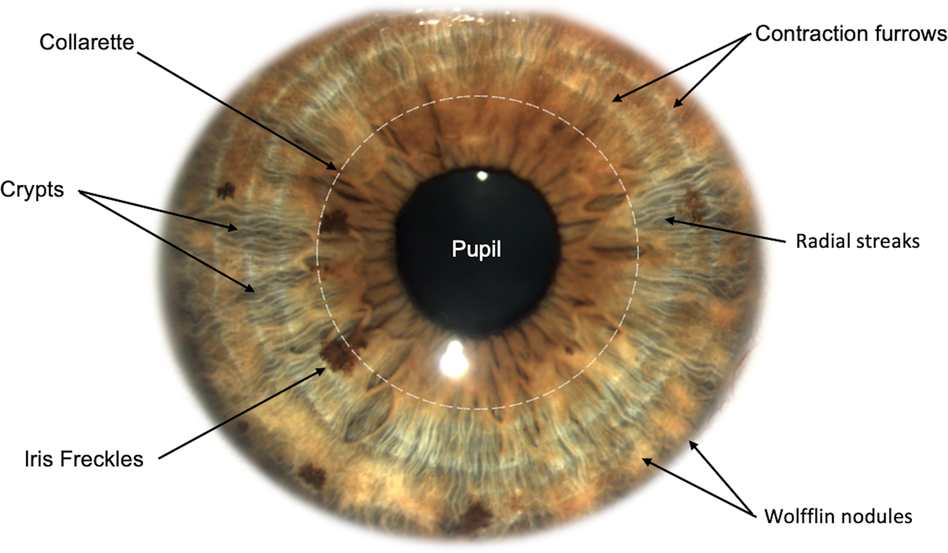

Slide 8
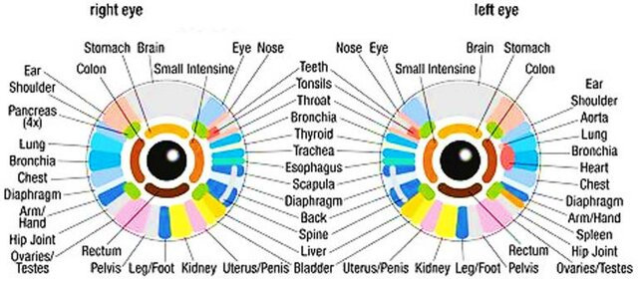

Slide 9
Technology Behind Iris Diagnosis System
Feature Extraction
Algorithms extract specific features, such as texture, edges, and color patterns, which are then analyzed to identify potential health issues.
Machine Learning, Fuzzy, and AI
Machine learning models are trained along with Fuzzy to compare iris features with known patterns associated with different diseases.

Slide 10
Applications of Iris-Based Diagnosis
General Health Monitoring Iris diagnosis can be used for routine health checkups to monitor organ health and detect early signs of disease.
Chronic Disease Management This method helps in tracking chronic diseases like diabetes and liver dysfunction by observing changes in the iris over time.
Holistic Health Practices It is also popular in alternative medicine, where practitioners use iris readings to suggest holistic treatments.

Slide 11
Challenges and Limitations
Lack of Standardization Iris-based health diagnosis is not widely accepted by the medical community due to the lack of standardization.
Training of AI Models Building accurate models requires a large and diverse dataset of iris patterns linked to different health conditions.
Skepticism in Conventional Medicine This method is often viewed with skepticism by conventional medical practitioners, limiting its integration into mainstream healthcare.

Slide 12
Future of Iris Diagnosis
Integration with Wearable Tech Future systems could integrate with smart glasses or contact lenses to continuously monitor health through iris patterns.
Increased AI Integration With advancements in AI, the accuracy of iris diagnosis systems will continue to improve, making them more mainstream in healthcare.
Global Acceptance As more research validates the effectiveness of this method, it may become an accepted diagnostic tool in conventional medical practice.

Slide 13
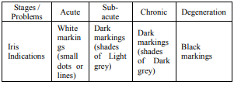
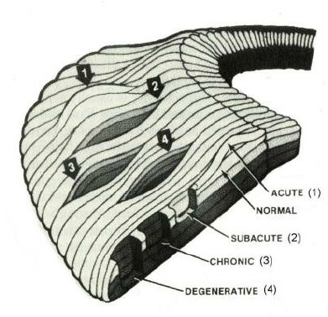
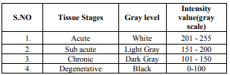
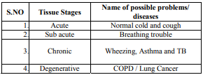
Four stages of iris tissue
Chronic obstructive pulmonary disease

Slide 14
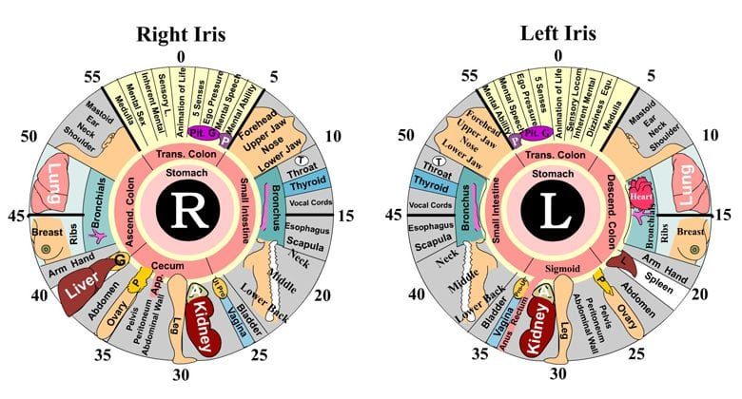
Iridology Eye Chart

Slide 15
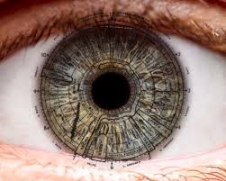
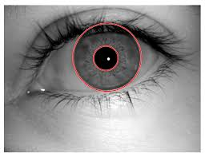

Slide 16
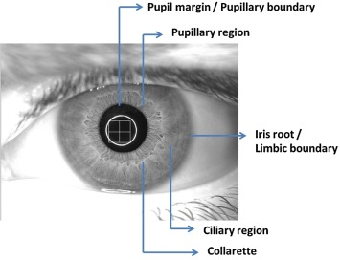
Overview of Pupil/Iris Ratio Determination
What is the Pupil/Iris Ratio? The pupil/iris ratio refers to the size relationship between the pupil (the central black part of the eye) and the surrounding iris (the colored part of the eye). It measures the diameter of the pupil in relation to the diameter of the iris.
Importance in Medical and Health Fields Variations in the pupil/iris ratio can indicate different physiological and neurological conditions. Monitoring this ratio is used in diagnostic processes and medical evaluations.

Slide 17
Applications of Pupil/Iris Ratio Determination
Medical Diagnostics The pupil/iris ratio is a valuable diagnostic tool for detecting conditions such as:
Neurological Disorders: Abnormalities in the ratio may indicate neurological diseases like multiple sclerosis(tissue hardening), brain injury, or stroke.
Eye Health Monitoring: The ratio can help in detecting eye diseases such as glaucoma and cataracts, as changes in the pupil size could be indicative of these conditions.
Autonomic Nervous System Testing: Abnormal pupillary responses (too large or too small) are often linked to dysfunctions of the autonomic nervous system.

Slide 18
Response to Medications
The pupil/iris ratio can be monitored to assess how certain medications affect the body, especially those that influence the nervous system.
Psychological and Emotional Analysis
Pupil dilation is linked to emotional states such as fear, arousal, or cognitive workload. By monitoring the pupil/iris ratio, it’s possible to infer the emotional or psychological state of an individual.

Slide 19
Fatigue and Alertness Monitoring
Changes in the pupil/iris ratio can indicate levels of fatigue or alertness.
For instance:
Pupil Dilation: Associated with increased alertness or a fight-or-flight response.
Pupil Constriction: Can suggest drowsiness or decreased cognitive function. This has applications in fields such as driver safety and workplace performance.

Slide 20
Cardiac Health Link
Changes in the autonomic nervous system, which controls the heart, can affect the size of the pupil.
By analyzing the pupil/iris ratio, we can gather insights into heart-related conditions.
Specifically, abnormal pupil reactions can indicate problems with blood circulation, heart rate regulation, or overall cardiovascular health.

Slide 21
Pupil Dilation Response to Cardiac Events
Pupil dilation is a known marker of acute cardiac events, such as myocardial infarctions (heart attacks). During a cardiac emergency, the body goes into a stress mode, triggering sympathetic nervous system activation, which dilates the pupils.
How It's Measured: During or following an acute cardiac event, clinicians can observe an abnormally high pupil/iris ratio due to the dilation of the pupil. In patients who experience cardiac arrest or severe arrhythmias, this dilation is often a sign of extreme autonomic nervous system dysfunction.
When It Occurs: This ratio increase is typically seen in the moments during or immediately after a heart attack or major cardiovascular event.

Slide 22
When Should Pupil/Iris Ratio Monitoring Be Conducted for Cardiac Health?
Routine Cardiovascular Check-Ups In patients with a history of cardiovascular problems or those at high risk (e.g., hypertension, diabetes, family history of heart disease), pupil/iris ratio monitoring can be a non-invasive method for detecting early signs of heart issues.
During Regular Exams: A simple pupil/iris ratio test can be done as part of an annual physical or cardiovascular check-up to monitor autonomic nervous system health.

Slide 23
Post-Cardiac Event Monitoring After a heart attack, stroke, or other major cardiovascular event, monitoring the pupil/iris ratio can provide information about autonomic nervous system recovery and overall heart function.
During Rehabilitation: Pupillary response can be measured during cardiac rehabilitation to assess recovery progress and the effectiveness of treatments.
After Surgery: Patients who undergo cardiac surgeries, like bypass or valve replacement, can have their pupil/iris ratio monitored post-operatively to detect any disruptions in autonomic function related to the heart.

Slide 24
Continuous Monitoring for High-Risk Patients Patients with chronic cardiovascular conditions like heart failure or arrhythmias can benefit from ongoing monitoring of their pupil/iris ratio.
Remote Monitoring: Wearable technology that tracks the pupil/iris ratio could be used to continuously monitor these patients and alert healthcare providers to abnormal patterns that might indicate worsening cardiac health.

Slide 25
What Can Abnormal Pupil/Iris Ratios Indicate About Cardiac Health?
Hypertension (High Blood Pressure) Patients with hypertension often exhibit an enlarged pupil/iris ratio, as the sympathetic nervous system tends to be overactive, leading to pupil dilation. This could serve as an early warning sign of hypertension-related damage to the cardiovascular system.
Example: Studies have shown that individuals with chronic high blood pressure tend to have larger-than-average pupils when compared to healthy individuals, indicating heightened sympathetic activity.

Slide 26
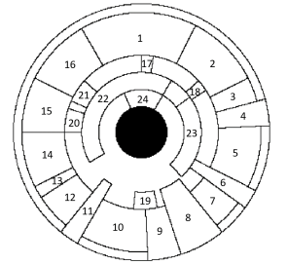
Autonomic Dysfunction in Diabetic Patients Diabetic patients, especially those with poorly controlled diabetes, are at higher risk for cardiac autonomic neuropathy, which disrupts the regulation of both heart rate and pupil size. An abnormally high pupil/iris ratio in diabetic patients can indicate the presence of this dangerous complication.
Why It Happens: Diabetes can damage the nerves that regulate both the pupil and the heart, leading to autonomic imbalance, which presents as an abnormal ratio and heart irregularities.
For the application to diabetes screening, we select region 21, which corresponds to the pancreas, the organ that produces insulin and regulates blood glucose levels.

Slide 27
Sudden Cardiac Events (Heart Attack) During a heart attack or other acute cardiac events, the pupil may dilate suddenly and significantly, resulting in an elevated pupil/iris ratio. This is due to the body's sudden sympathetic nervous system response.
What It Indicates: A sudden dilation of the pupil in a patient experiencing chest pain or other heart-related symptoms could signal an impending heart attack and should be treated as a medical emergency.

Slide 28
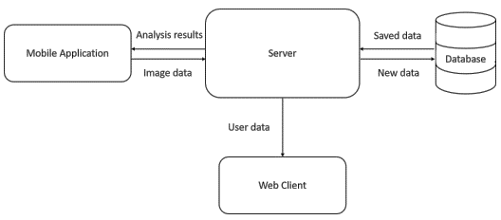
System architecture for iris diagnostics platform

Slide 29
Steps in the Iris Health Mapping
Step 1: Image Capture
A high-definition camera captures a clear image of the iris.
Step 2: Preprocessing
The image is preprocessed to enhance contrast and remove noise for better clarity.
Step 3: Feature Extraction
Specific iris patterns like crypts, fibers, and rings are identified and extracted.
Step 4: Health Mapping
The extracted features are compared to a database of known health-related iris patterns.

Slide 30
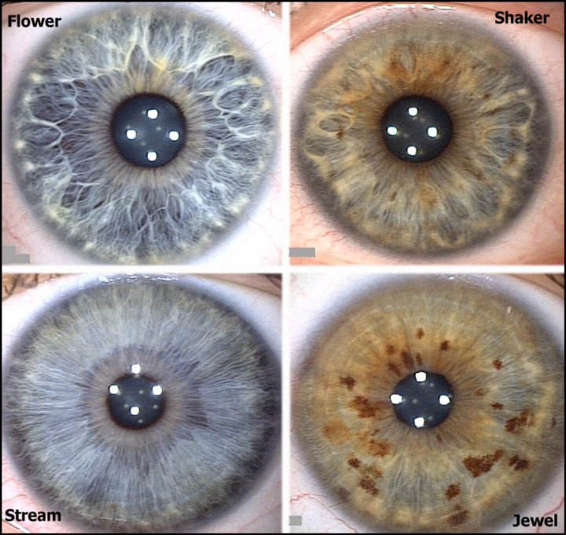

Slide 31
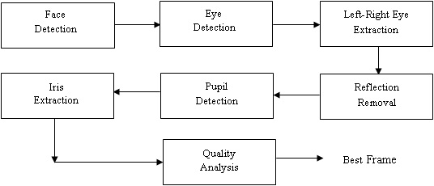

Slide 32
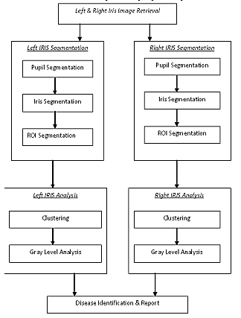
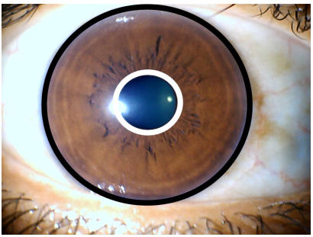

Slide 33
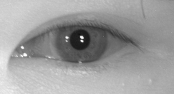
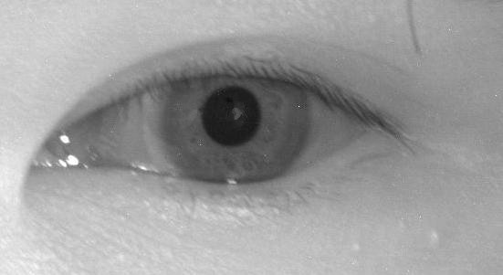
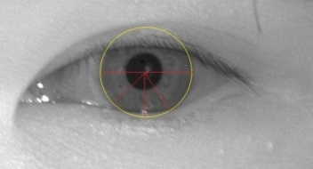

Removed Specular Reflection
Original Image
Thresholding
Detected Iris

Slide 34
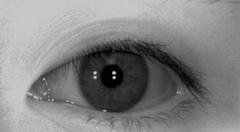
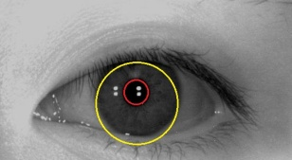
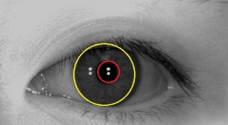
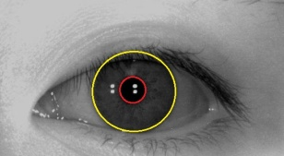
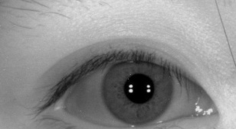
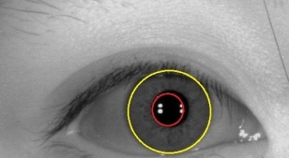


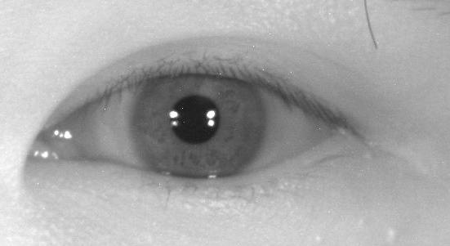
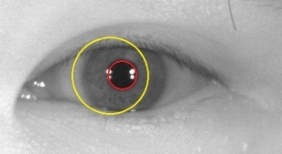
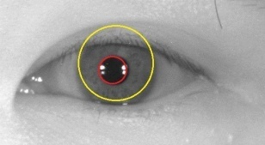
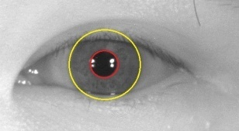
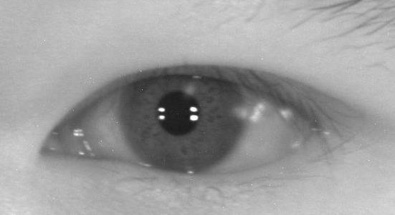
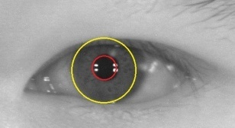
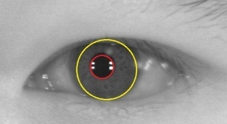
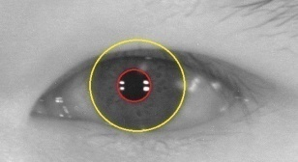

Slide 35
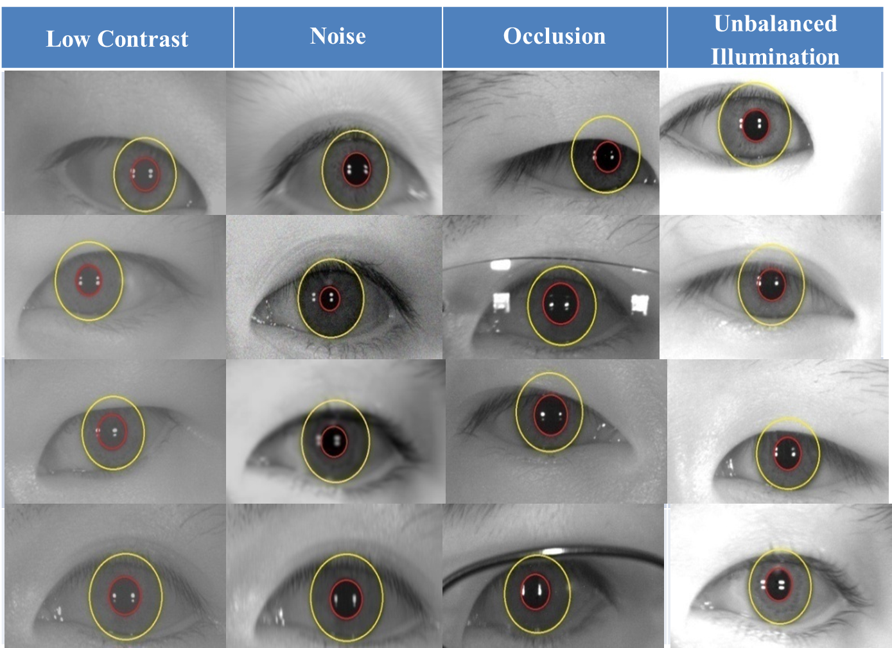

Slide 36
Our Approach
Mediapipe Face Mesh
Distance threshold range (in cm) and the corresponding pixel distance range
Flip and convert the image to RGB
Process the image and detect face landmarks

Slide 37
Function to calculate the distance between two landmarks
Calculate the distance between the outer corners of the eyes
Check if the person is within the 59-60 cm range
Function to calculate center and radius for given indices
Calculate and draw circles for left iris / right iris
Calculate and draw circles for left pupil / right pupil

Slide 38
Mediapipe Face Mesh
Employs machine learning (ML)
ML pipeline consists of two real-time deep neural network models that work together:
A detector that operates on the full image and computes face locations and
a 3D face landmark model that operates on those locations and predicts the approximate 3D surface via regression.

Slide 39
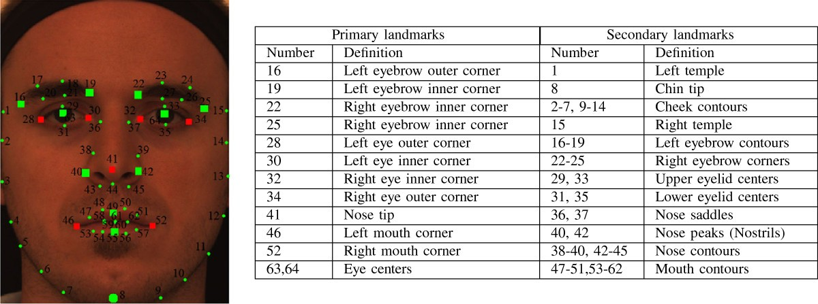

Slide 40
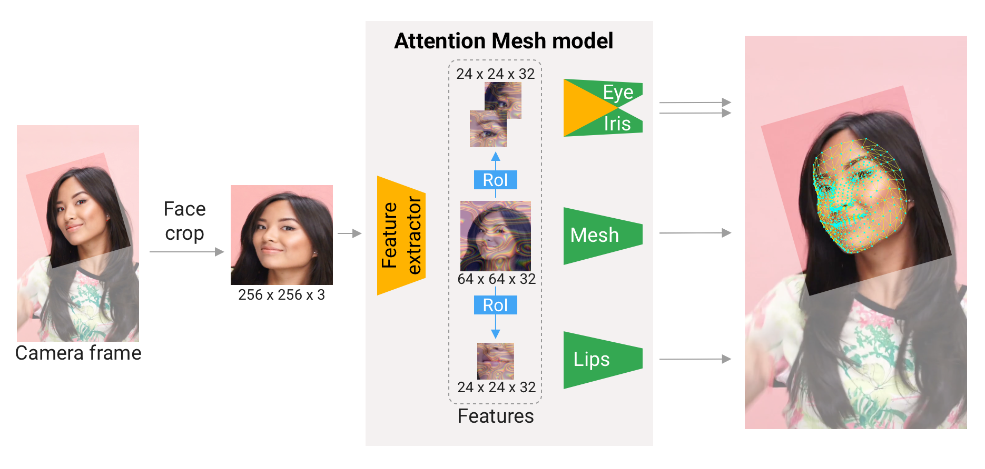
Attention Mesh: Overview of model architecture

Slide 41

A visualization of multiple key elements in the Metric 3D space

Slide 42

An example of face effects rendered by the Face Transform Effect Renderer

Slide 43
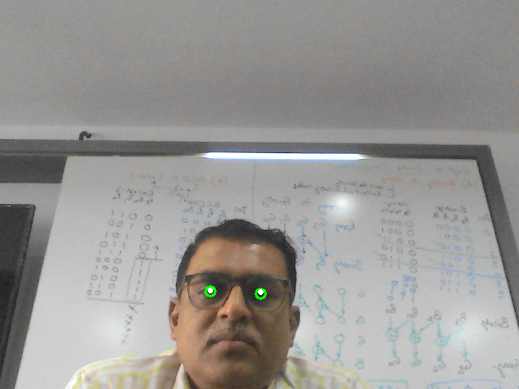
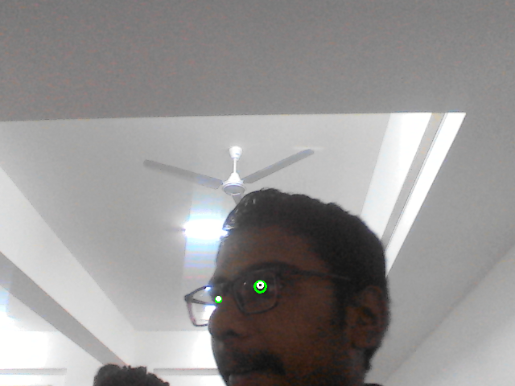

Slide 44
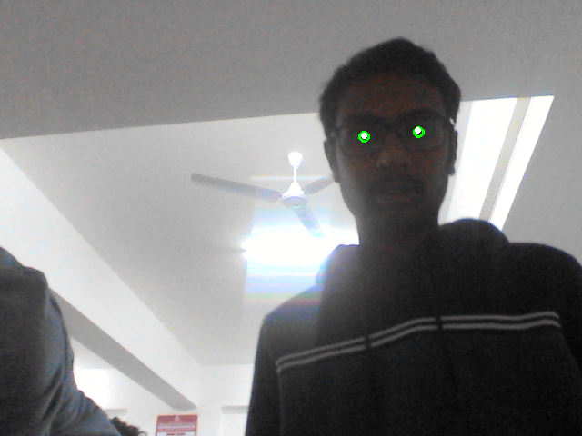
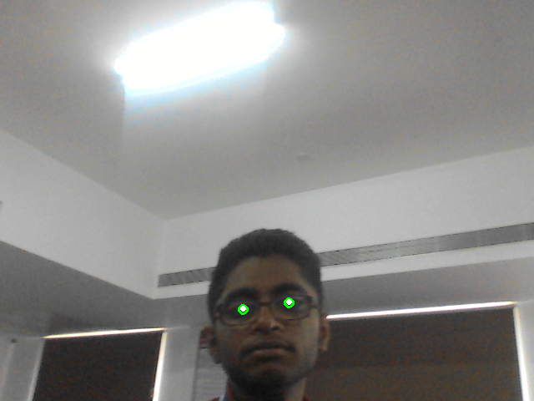
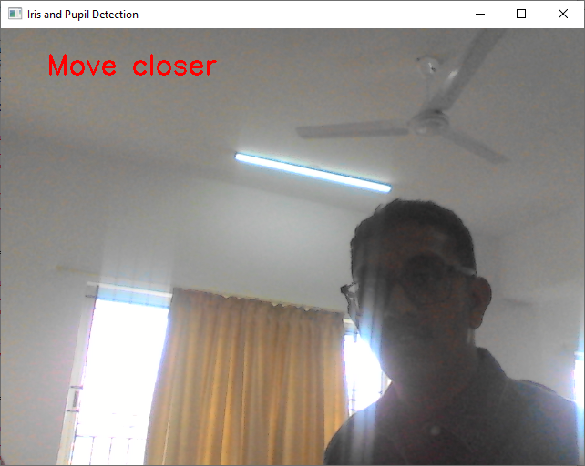

Slide 45


Slide 46


Slide 48
 | Left Pupil/Iris Ratio | Right Pupil/Iris Ratio
Min | 0.2500 | 0.2000
Max | 0.5000 | 0.5714
Avearage | 0.3965 | 0.3952
Variance | 0.005306 | 0.004707
Standard Deviation | 0.07284 | 0.068608
Variation
with min | 0.1465 | 0.1952
with max | 0.1035 | 0.1763

Slide 52
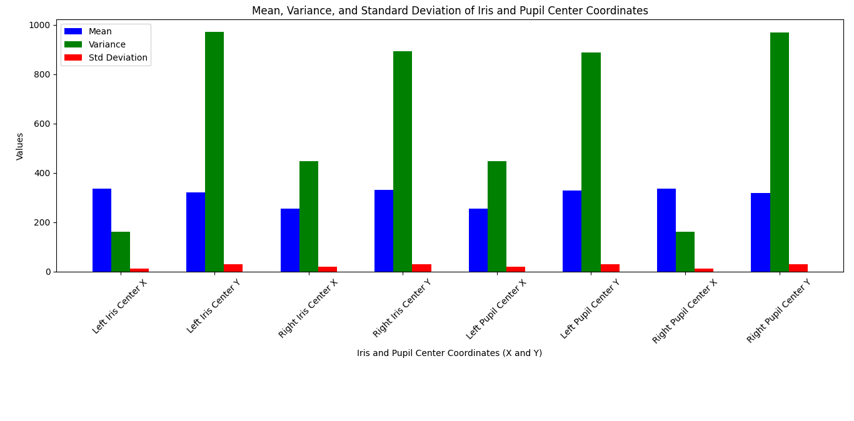

Slide 53
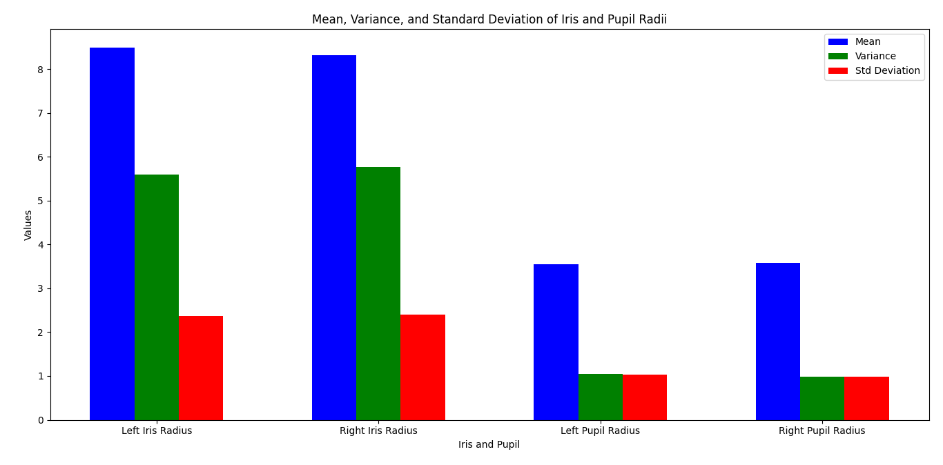

Slide 54

Implementation Details
RAJESH G D
NORIN ROBY ISSAC
VARUN ACHAR

Slide 55


